Slide 1
Language-based generative models for drug design
Morgan Thomas
Centre for Molecular Informatics, University of Cambridge, UK
International Conference on Chemical Structures
16/06/2022

Slide 2
Contents
Background
Recurrent neural networks for de novo molecule generation
Poor sample efficiency of reinforcement learning
Augmented Hill-Climb
Adaptation of REINVENT optimization algorithm to AHC
Comparison to REINVENT on docking tasks
Benchmarking against RL algorithms
MolScore platform
What is it?
What can it do?

Slide 3


Recurrent neural networks for de novo design
Molecular graph
Molecular language
Technically
“C”
CC(=O)Nc1ccc(O)cc1
One-hot encoding
Paracetamol
Paracetamol
0 | 0 | 0 | 0 | 1 | 0 | 0 | 0 | 0 | 0
RNN
Hidden state
GO
C
C
(
=
O
)
N
c
1
c
c
c
(
O
)
c
c
1
Recurrent neural network
0.09 | 0.04 | 0.31 | 0.02 | 0.41 | 0.09 | 0.01 | 0.01 | 0.01 | 0.01
0 | 0 | 0 | 0 | 1 | 0 | 0 | 0 | 0 | 0
C
C
C
C
O
)
N
=
1
c
c
c
c
C
)
c
c
1
END
Maximize the likelihood assigned to the correct token

Slide 4
Recurrent neural networks for de novo design
GO
C
C
(
=
O
)
N
c
1
c
c
c
(
O
)
c
c
1
Technically
Recurrent neural network
“GO”
One-hot encoding
C
C
(
=
O
)
N
c
1
c
c
c
(
O
)
c
c
1
END
0 | 0 | 0 | 0 | 1 | 0 | 0 | 0 | 0 | 0
RNN
Hidden state
Paracetamol
See Noel’s poster for performance of other languages
SMILES: Cc1cc(-c2nnc(N)nc2-c2ccc(F)cc2)cc(Cl)n1
DeepSMILES[1]: Ccccccn6)Cl)))ccncnn6))N)))cccccc6))F
SELFIES[2]: [C][C][=C][C][Branch2_1][Ring1][Branch1_3][C][=N][N][=C][Branch1_1][C][N][N][=C][Ring1][Branch1_3][C][=C][C][=C][Branch1_1][C][F][C][=C][Ring1][Branch1_3][=C][C][Branch1_1][C][Cl][=N][Ring2][Ring1][Branch1_1]
0.09 | 0.04 | 0.31 | 0.02 | 0.41 | 0.09 | 0.01 | 0.01 | 0.01 | 0.01
Sample from probability distribution
HTL1071: A_{2a} antagonist
[1] O'Boyle, N.M., Dalke A. ChemRxiv (2018) [2] Krenn, M., et al. Mach learn: sci technol 1 (2020)

Slide 5
Common optimization algorithms for RNNs
Fine-tuning / transfer learning (e.g., [1])
Reinforcement learning (e.g., [2, 3])
Train on large dataset
Train on large dataset
10⁶-10⁷ SMILES
e.g., ChEMBL
10⁶-10⁷ SMILES
e.g., ChEMBL
1.
RNN
1.
RNN
Use pre-trained
RNN
Use pre-trained
RNN
Train on small
dataset
Update RNN
10¹-10³ SMILES
e.g., DRD2
Scoring function(s)
2.
RNN
2.
RNN
Sample molecules
RNN
RNN
Performance
[4] GuacaMol: 2nd of 4
[5] MOSES: 1st of 8
[6] Smina benchmark: 1st of 3
[7] TDC docking benchmark: 1st of 5
State-of-the-art is still ill-defined
Most common model by publications [8]
Valid de novo SMILES strings similar to project data
Valid de novo SMILES strings maximizing objective function
Requires project data
Restricted novelty
Scoring function may also require project data
Model can exploit scoring function pitfalls
Multi-parameter optimization difficult
[1] Segler, M.H.S., et al. ACS Cent. Sci. 4, 1 (2018) [2] Neil, D., et al. ICLR 2018 conference proceedings (2018) [3] Olivecrona, M., et al. J Cheminform 9, 48 (2017) [4] Brown, N., et al. JCIM 59, 3 (2019) [5] PolyKovskiy, D., et al. Front Pharmacol 11 (2020) [6] Cieplinski, T. et al. arXiv (2020) [7] Huang, K., et al. arXiv (2021) [8] Martinelli, D., et al. Comput Biol Med 145 (2022)

Slide 6
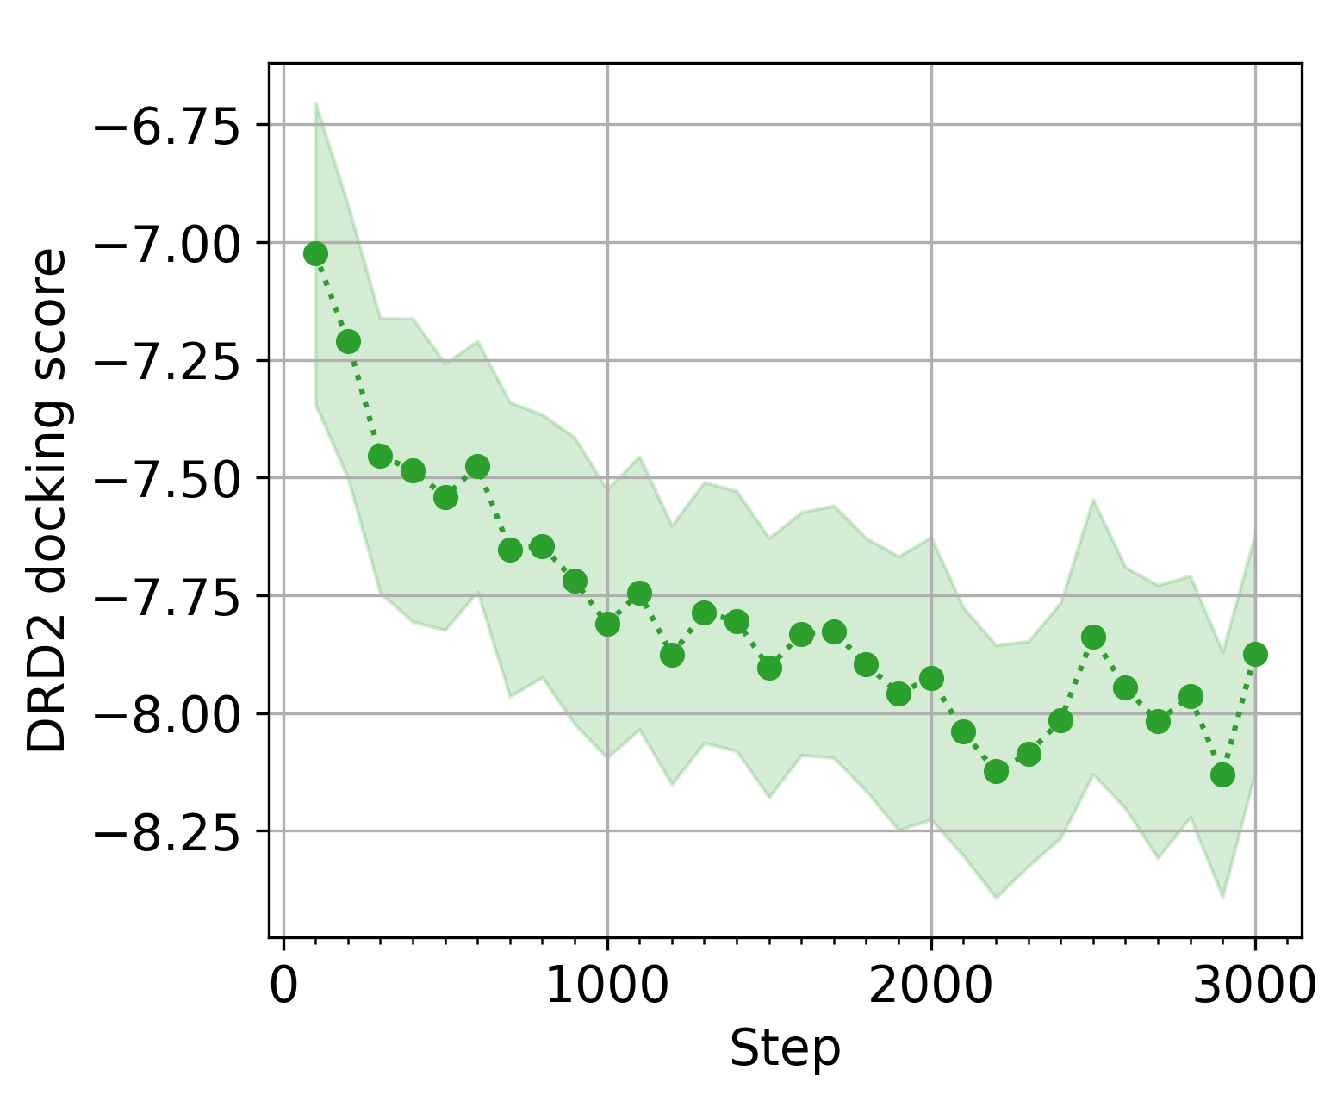
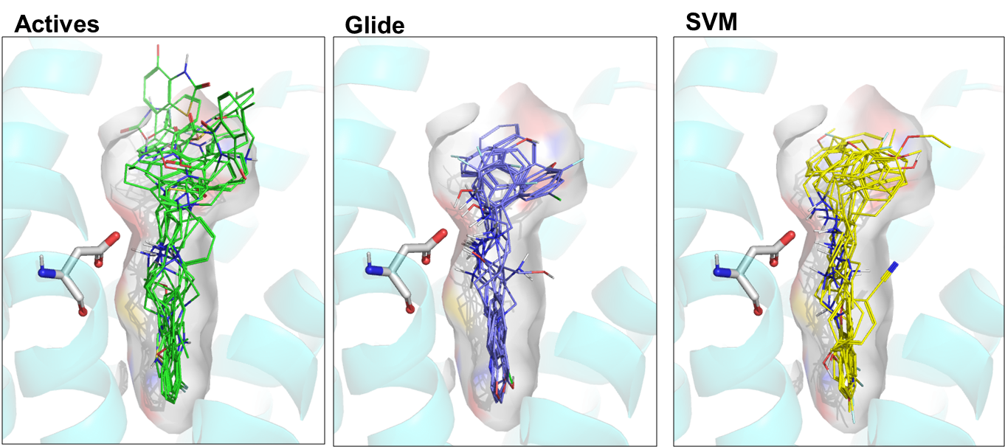
Reinforcement learning limits use of more expensive scoring functions
Reinforcement learning requires many samples
Benefits of docking over QSAR models [2]
Glide - Agent
SVM - Agent
known D₂ actives
# Molecules required
LSTM-HC in GuacaMol [1]: 163,840
Own work [2]: 128,000
Dockstream [3]: 102,000 – 128,000
* Depends on training dataset and difficulty of task
Ligand data not required
Models directly learn critical residue interactions
Relative to QSAR scoring function
Greater coverage of known active space
Greater chemotype diversity achieved
‘Medium’ time scoring functions too slow e.g., docking, CASP
Requirement for large compute resources e.g., AWS
Access to time (~2,857 CPU hrs [2], 48 - 6000 CPU hrs [3])
How can we improve reinforcement learning sample efficiency?
[1] Brown, N., et al. JCIM 59, 3 (2019) [2] Thomas, M., et al. J Cheminform 13, 39 (2021) [3] Guo, J., et al. J Cheminform 13, 89 (2021)

Slide 7
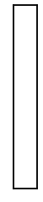

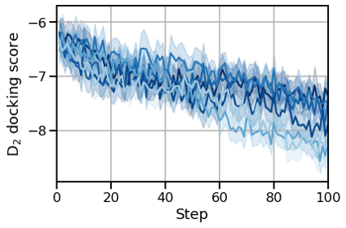
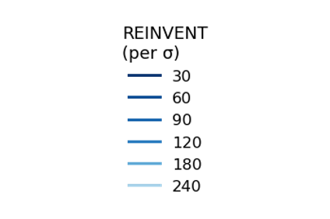
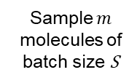
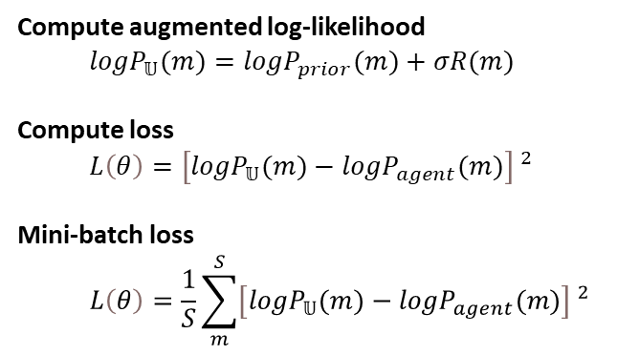
REINVENT optimization algorithm
Sample $m$ molecules of batch size S
Compute augmented log-likelihood
${logP}_{𝕌}(m)={logP}_{prior}(m)+σR(m)$
Compute loss
$$L\left(θ\right)=\left[{logP}_{𝕌}(m)−{logP}_{agent}(m)\right] ^{2}$$
Mini-batch loss
$$L\left(θ\right)=\frac{1}{S}\sum_{m}^{S}{\left[{logP}_{𝕌}(m)−{logP}_{agent}(m)\right] ^{2}}$$
Contribution of prior log-likelihood and scaled (σ) reward - target policy
RNN_{agent}
each with probability P_{agent}
Assign reward
Score
Scoring function
Minimize distance between target policy and agent policy
R [0,1]
RNN_{prior}
and prior probability P_{prior}
Increase reward contribution via σ
REINVENT [1]
σ has small effect on a short time scale
REINVENT 2.0 & 3.0 [2]
[1] Olivecrona, M., et al. J Cheminform 9, 48 (2017) [2] Blaschke, T., et al. JCIM 60, 12 (2020)

Slide 8

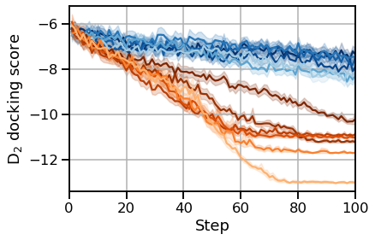
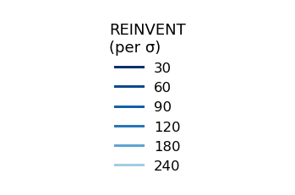
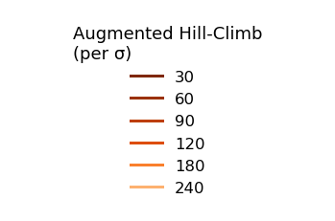
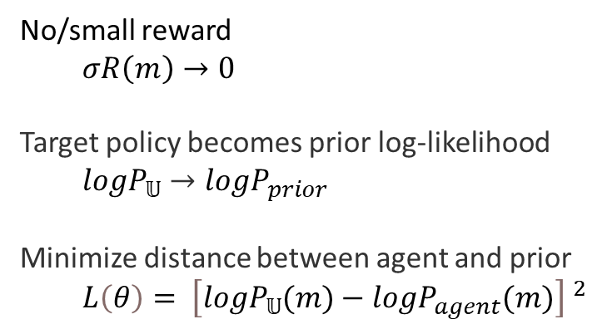
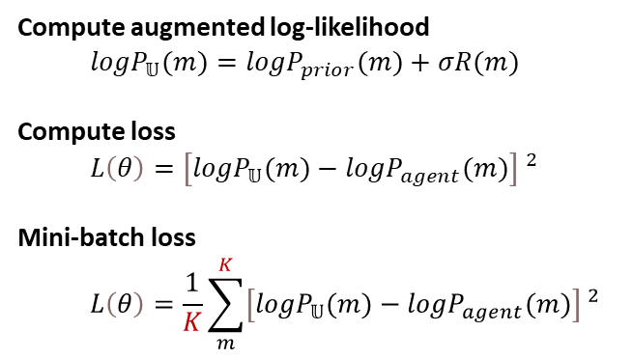
Augmented Hill-Climb optimization algorithm
Sample $m$ molecules of batch size S
Compute augmented log-likelihood
${logP}_{𝕌}(m)={logP}_{prior}(m)+σR(m)$
Compute loss
$$L\left(θ\right)=\left[{logP}_{𝕌}(m)−{logP}_{agent}(m)\right] ^{2}$$
Mini-batch loss
$$L\left(θ\right)=\frac{1}{K}\sum_{m}^{K}{\left[{logP}_{𝕌}(m)−{logP}_{agent}(m)\right] ^{2}}$$
RNN_{agent}
Rank by reward
each with probability P_{agent}
Assign reward
Score
Scoring function
R [0,1]
Select K top molecules
RNN_{prior}
and prior probability P_{prior}
Use importance sampling to focus on samples with most information (positive) rewards - a.k.a Hill-Climb [1]
Sparse reward scenario (early learning / complex objective)
No/small reward
$$σR\left(m\right)→0$$
Target policy becomes prior log-likelihood
$${logP}_{𝕌}→{logP}_{prior}$$
Minimize distance between agent and prior
$$L\left(θ\right)= \left[{logP}_{𝕌}(m)−{logP}_{agent}(m)\right] ^{2}$$
Optimization power and efficiency increased
[1] Neil, D., et al. ICLR 2018 conference proceedings (2018)

Slide 9
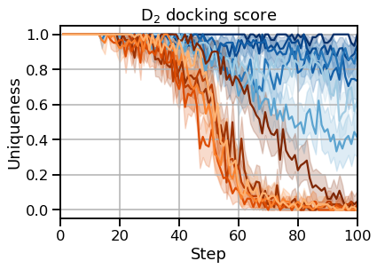
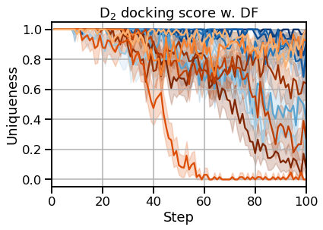
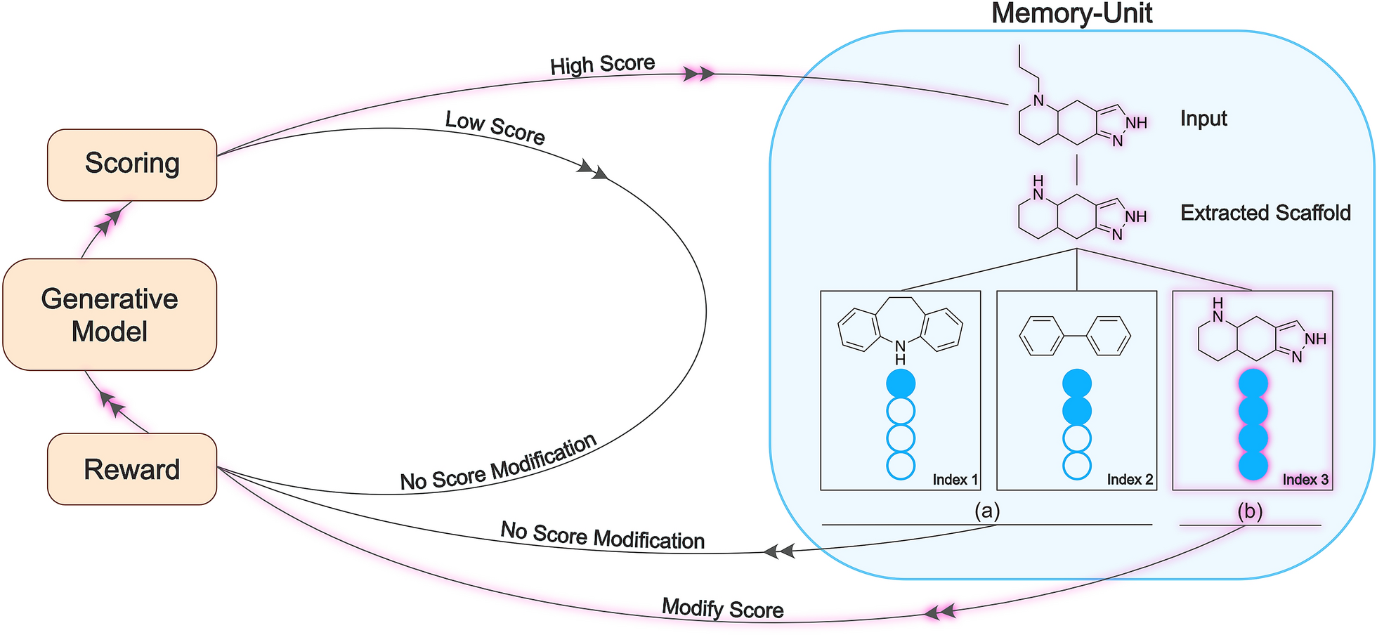
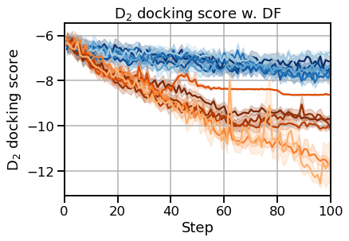
Diversity filter required to rescue mode collapse
Applying diversity filter [1] rescues mode collapse
Uniqueness decreases as model goes into mode collapse
Uniqueness rescued by diversity filter
[1] http://creativecommons.org/licenses/by/4.0/
AHC with DF maintains optimization power & efficiency over REINVENT when optimizing D₂ docking score
[1] Blaschke, T., et al. J Cheminform 12, 68 (2020)

Slide 10
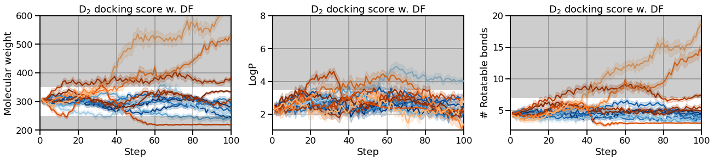
Tuning σ has greater effect on chemical space generalizability
*MOSES^{n} [1, 2] used for prior training
*MOSES^{n} only includes molecules with:
250 <= MW <= 350
LogP <= 3.5
# rotatable bonds <= 7
AHC: higher σ values generalize to restricted property space
AHC: lower σ values maintain property space
REINVENT: Same σ range has much less control on generalization
[1] Polykovskiy, D., et al. Front. Pharmacol. 11, 565644 (2020) [2] Thomas, M., et al J Cheminform 13, 39 (2021)

Slide 11
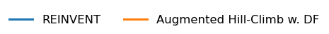
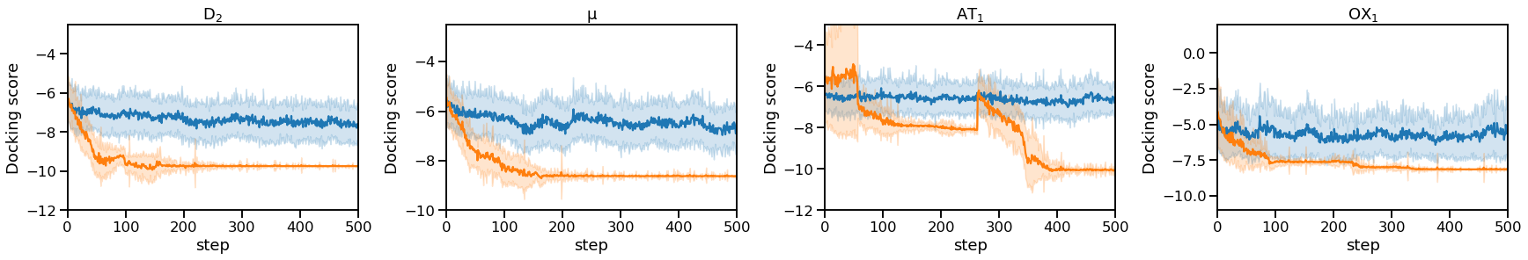
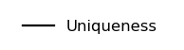
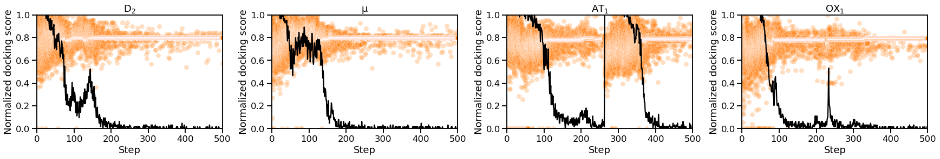
AHC can exploit diversity filter parameters
Extending AHC with DF over 500 steps reveals further mode collapse ~ 200 steps
AHC optimization converges at minimum score threshold (0.8) as it learns to avoid diversity filter penalization

Slide 12
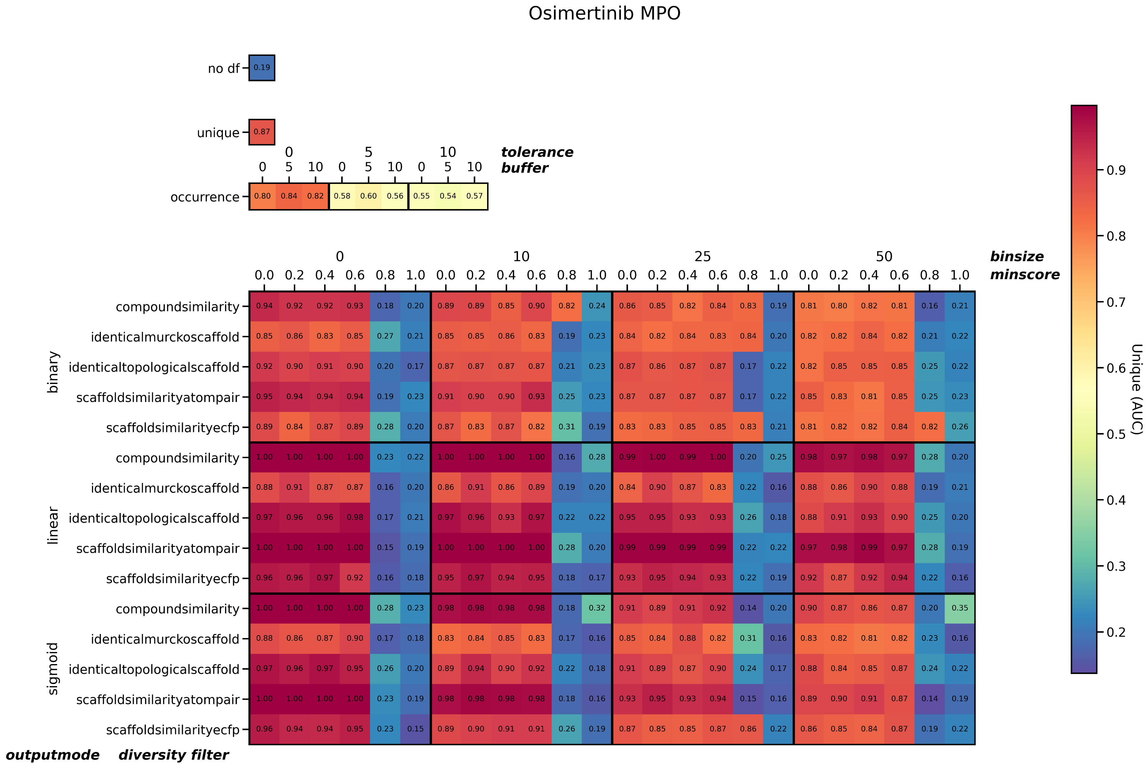
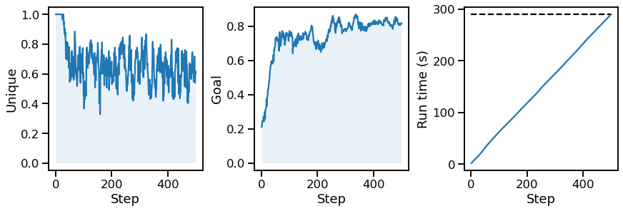
Diversity filter hyperparameter search
Experiment
Example outcome
RNN_{prior}
RNN_{agent}
AHC
500 steps
Diversity filter
GuacaMol
Scoring function
Aripiprazole similarity C₁₁H₂₄ isomers
Osimertinib MPO
Endpoints
Observations
Minimum score threshold < 0.5
Softer gradient of penalization e.g., linear / sigmoid penalization
Conflicting hyperparameters for uniqueness and goal

Slide 13
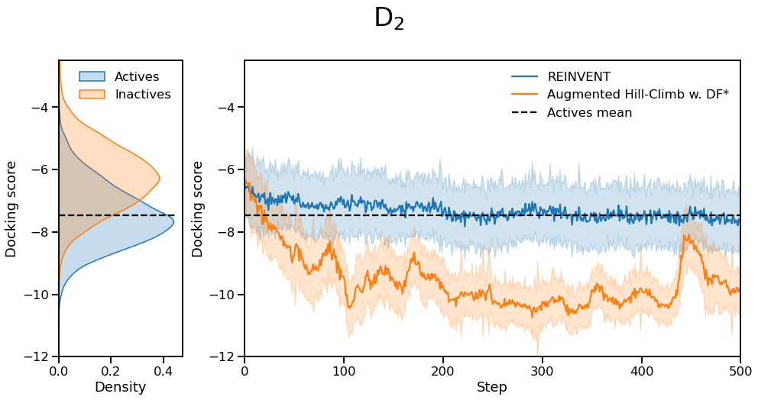
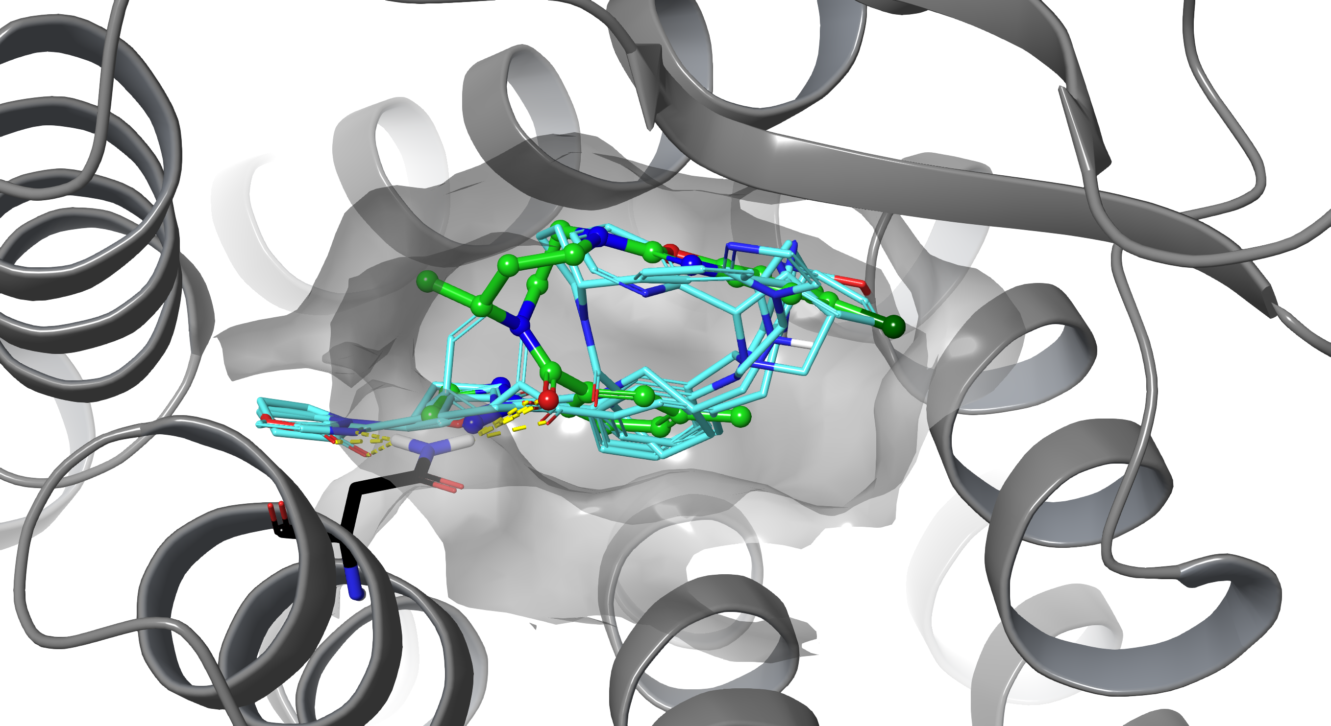
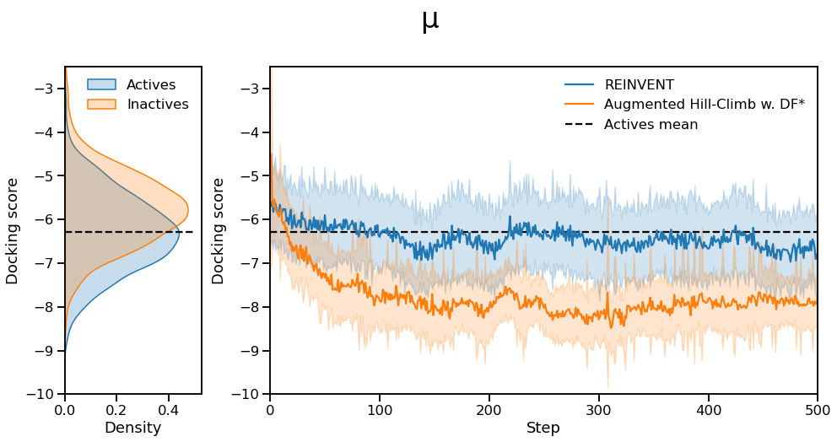
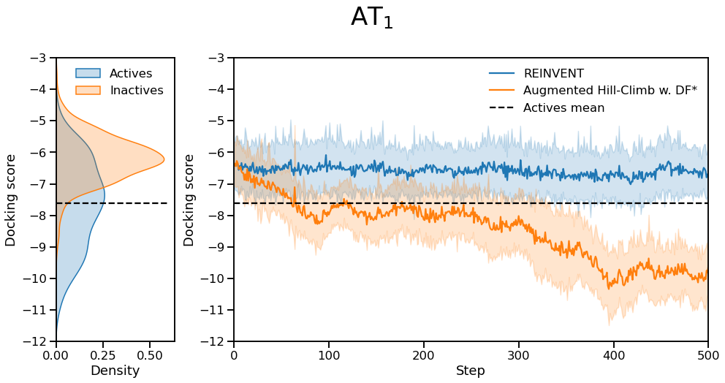
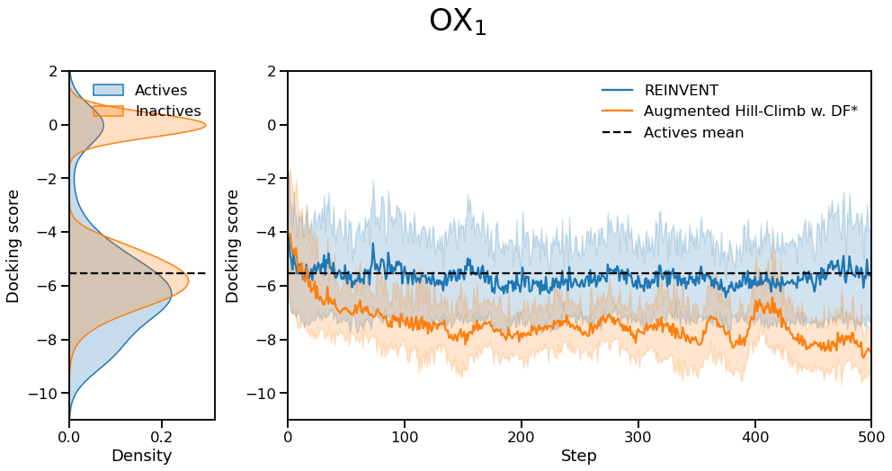
Sample efficiency improvements in optimizing GPCR docking scores
OX₁
Optimization ability
x1.4
(168%/121%)
Sample efficiency
x8.6
(163/19)
x1.5
x1.5​
x1.3​
x4.7
> x8.0
x0.6
# Samples to surpass mean score of known actives

Slide 14
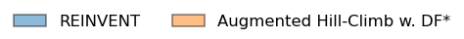
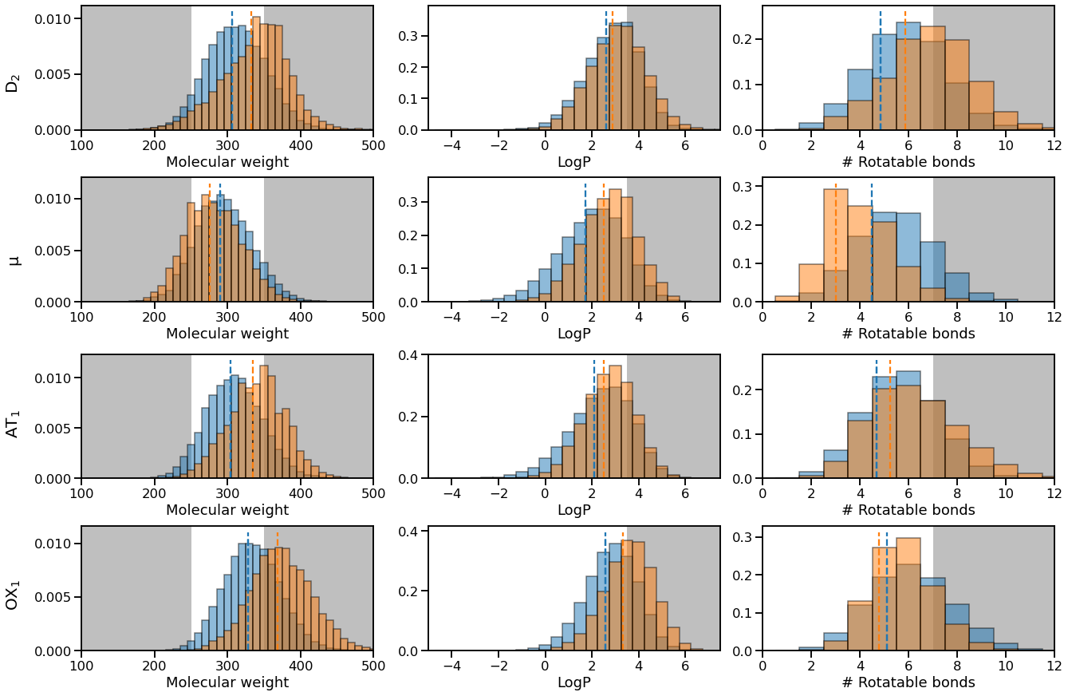
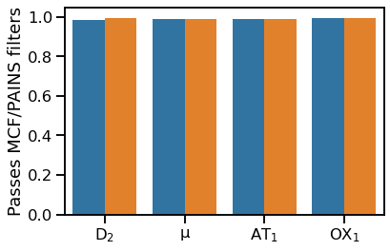
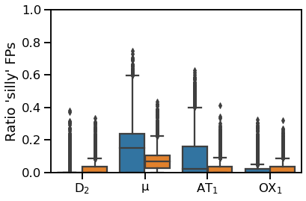
De novo chemistry remains as reasonable as REINVENT
Similar property distribution to REINVENT
Maintains similar ratio of molecules passing medicinal chemistry & PAINS filters
Fewer idiosyncratic fingerprint bits compared to training dataset than REINVENT

Slide 15
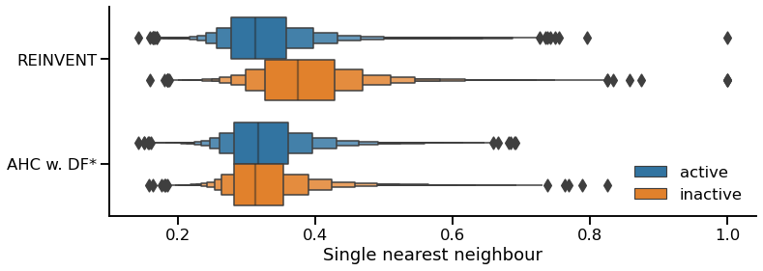
De novo chemistry remains as reasonable as REINVENT
Known active substructure
D₂
µ
REINVENT
AHC w. DF*
Similar similarity to actives
Less similarity to inactives
Known actives

Slide 16
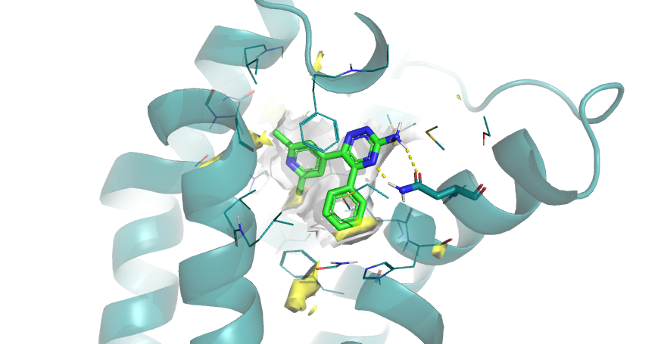
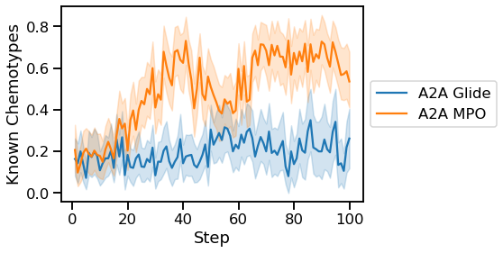
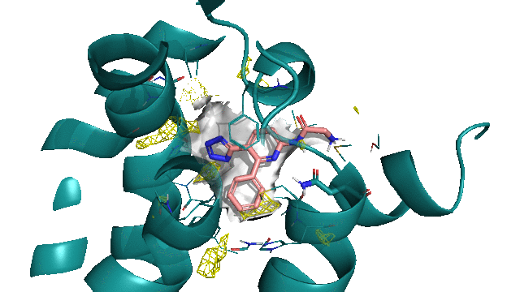
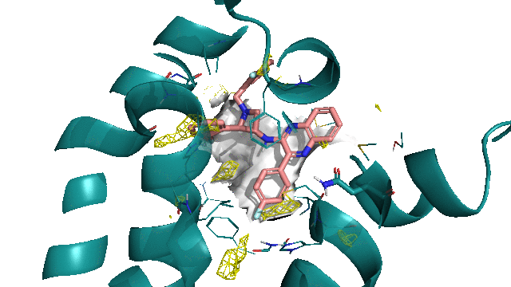
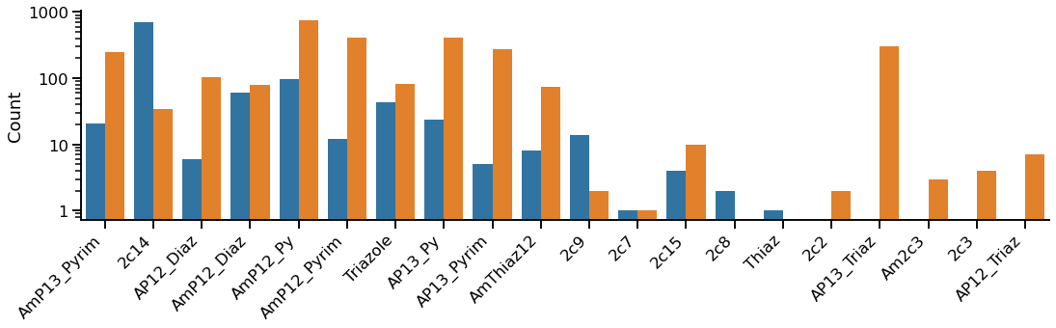
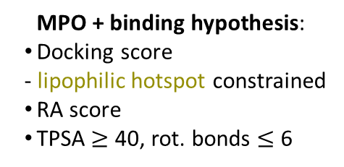
Disclaimer: docking score alone is not an adequate objective
MPO
A_{2a} MPO
MPO recovers more known A_{2A} scaffolds than Glide scoring alone
MPO + binding hypothesis:
Docking score
- lipophilic hotspot constrained
RA score
TPSA $≥$ 40, rot. bonds $≤$ 6
Glide scoring alone
AI in Chemistry 2021

Slide 17
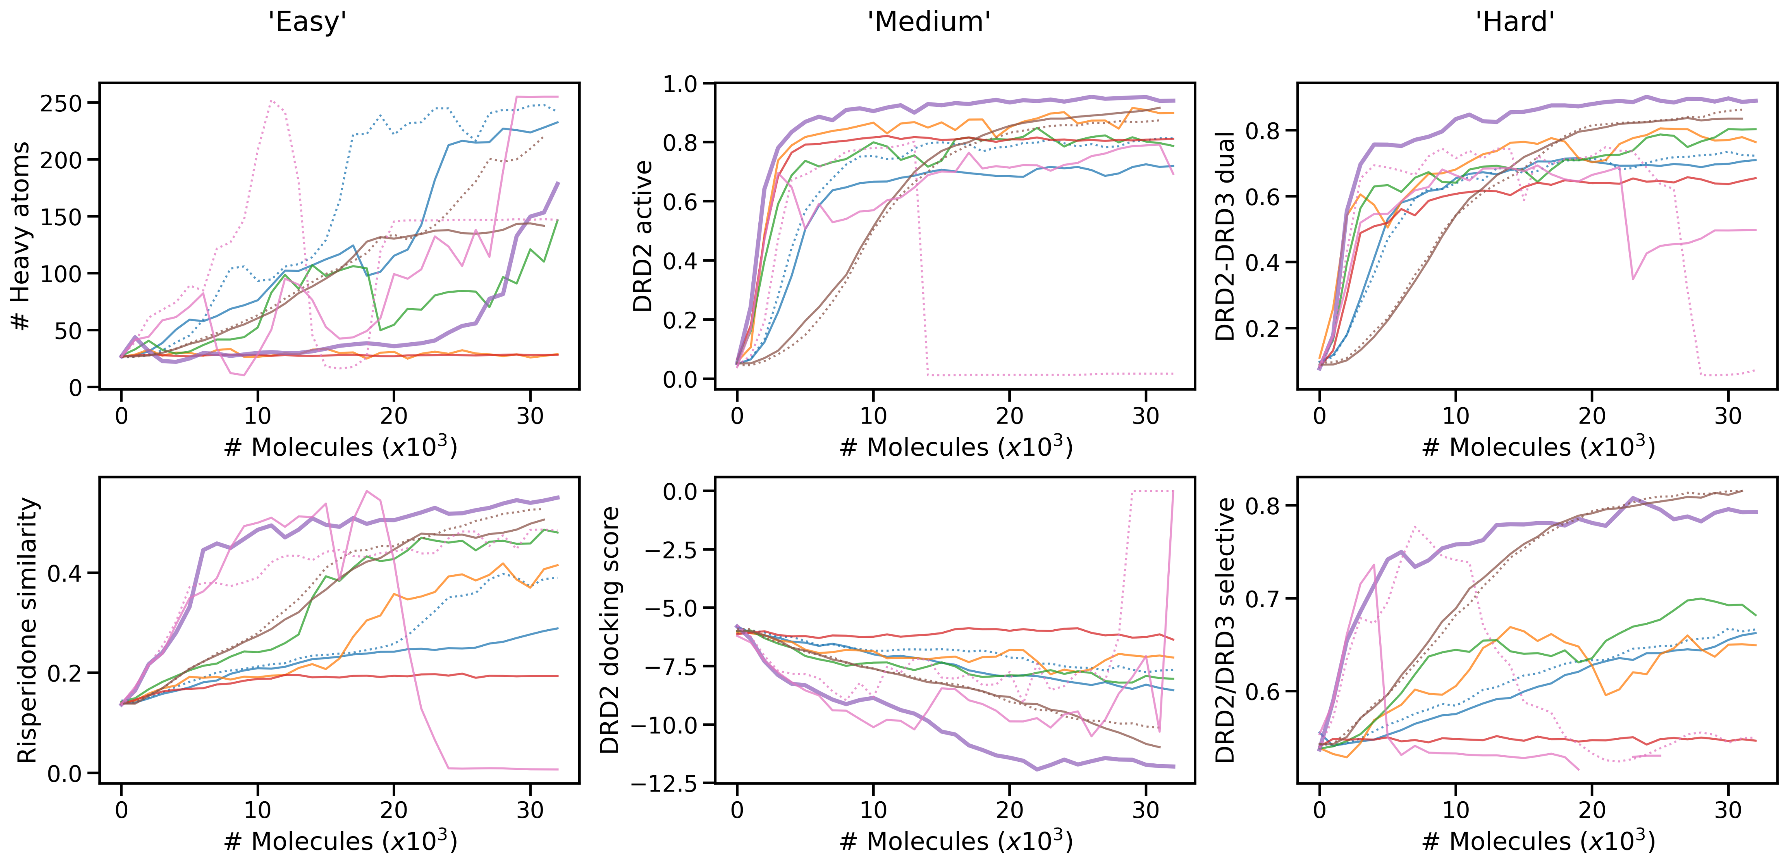
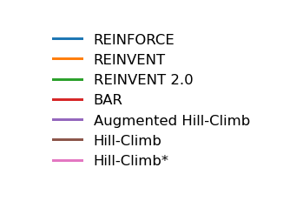
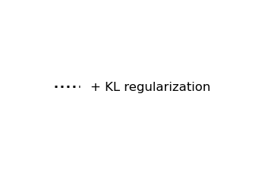
AHC more sample efficient than other common RL algorithms
All w. diversity filter
AHC is more sample efficient
HC* undergoes mode collapse
Code available: https://github.com/MorganCThomas/SMILES-RNN
This work used 834 scoring configurations ...

Slide 18
MolScore: A semi-automated platform for goal-directed generative model molecule scoring and evaluation
https://github.com/MorganCThomas/MolScore
MolScore manuscript in preparation

Slide 19
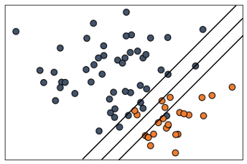
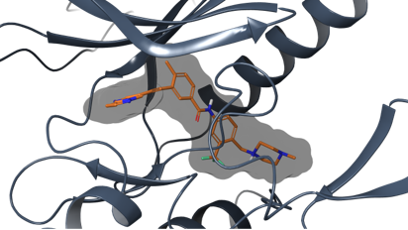

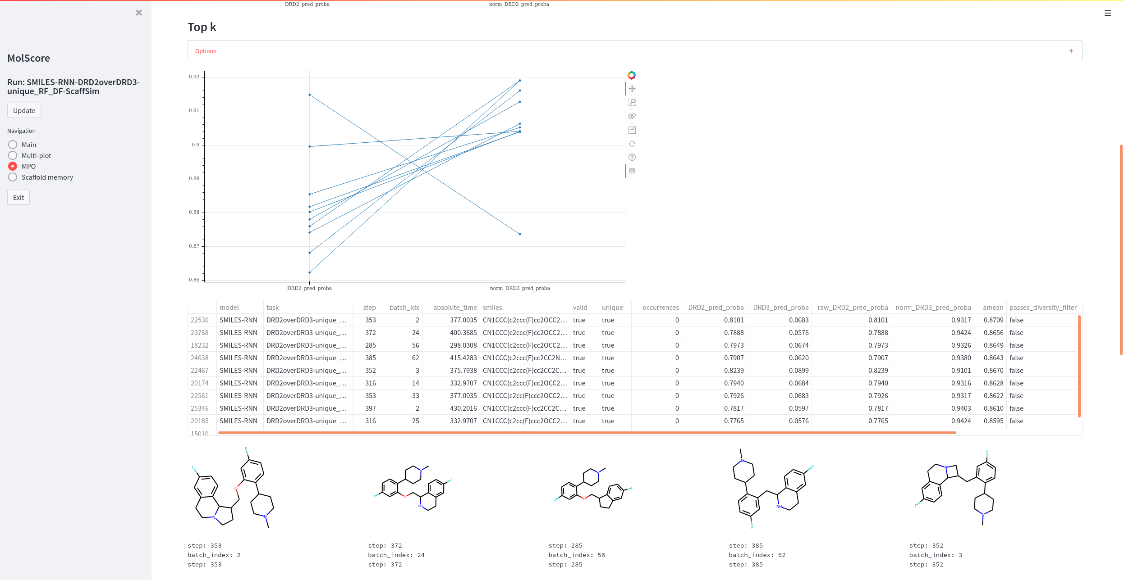
MolScore: What is it?
A python platform for de novo molecule scoring enabling easier model evaluation and comparison
Descriptors, similarity and substructure matches
Predictive models
Docking
Scoring functions
Score transformations
de novo molecules
Goal-directed generative model
MolScore
MPO aggregation methods
molecule scores
Live monitoring
Performance metrics
Easy to implement (3 lines of code)
Flexible
Configuration GUI
Monitor GUI
Standardized output
Suite of performance metrics

Slide 20
MolScore: What can it do?
Red=WIP
RDKit: Open-source cheminformatics. https://www.rdkit.org
Jin, W. et al. arXiv 1802.04364 (2019)
Brown, N., et al. J Chem Inf Model 59, 3 (2019)
Grant, J.A., et al. J Comput Chem 17, 4 (1996)
Pedregosa, F., et al. JMLR 12 (2011)
Chen, T., et al. arXiv (2016)
Yang, K., et al. J Chem Inf Model 59, 8 (2019)
Xiong, Z., et al. J Med Chem 63, 16 (2019)
Friesner, R.A., et al. J Med Chem 47, 6 (2004)
Koes, D.R., et al. J Chem Inf Model 26, 53 (2013)
Jones, G., et al. J Mol Biol 267, 3 (1997)
Korb, O., et al. LNCTS 4150, pp247-258 (2006)
McGann, M.R., et al. Biopolymers 68, 1 (2003)
Ragoza, M., et al. J Chem Inf Model 57, 4 (2017)
Ropp, P.J., et al J Cheminform 11, 34 (2019)
LigPrep: Schrodinger Release 2019-4
Milletti, F., et al. J Chem Inf Model 46, 6 (2007)
Ertl, P., et al. J Cheminform 1, 8 (2009)
Thakkar, A., et al. Chem Sci 12 (2021)
Genheden, S., et al. J Cheminform 12, 70 (2020)
Domenico, A. et al. J Chem Inf Model 60, 10 (2020)
Liu, X., et al. J Cheminform 13, 85 (2021)
Blaschke, T., et al. J Cheminform 12, 68 (2020)
Langevin, M., et al. chemRxiv (2022)
Polykovskiy, D., et al. Front Pharmacol 11 (2020)
Thomas, M., et al. J Cheminform 13, 39 (2021)
Zhang, J., et al. J Chem Inf Model 61, 6 (2021)
Preuer, K., et al. J Chem Inf Model 58, 9 (2018)
Collection of some of the cutting-edge work in the field
Scoring functions e.g.,
PhysChem descriptors [1]
2D & 3D similarity measures
Predictive models
Docking software’s
Ligand preparation protocols
Synthetic accessibility
Transformation functions e.g.,
Normalize
Linear threshold
Gaussian transformation
etc.
Diversity filters
Unique
Occurrence
Memory-assisted [23]
Performance metrics
GuacaMol [3]
MOSES [25]
FCD [28]
Sphere exclusion diversity [26]
Functional groups [27]
Ring systems [27]
Analogue similarity [23]
Analogue coverage
Applicability domain filters [24]
Maximum similarity
Feature range
PhysChem range
Aggregation functions
Weighted sum
Arithmetic mean
Geometric mean
Pareto pairs [21]
etc.

Slide 21

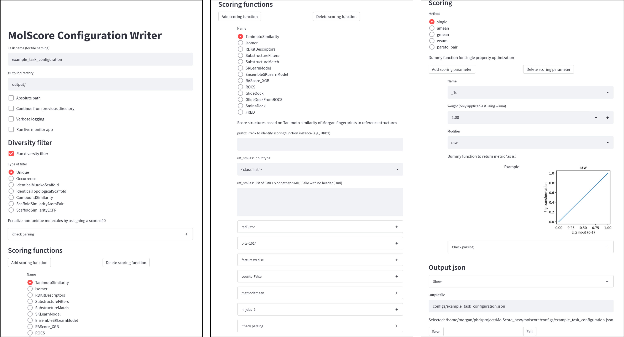
MolScore: writing the configuration file
The parameters of MolScore are defined in a json file, for example:
Streamlit app form for building config file that processes python docs and supplies parameters, format and descriptions
{ "logging": { "model": { "name": "GraphGA", }, "task": { "name": "QED", } }, "output_dir": "./molscore_results",
“live_monitor": true, "diversity_filter": { "run": false, "name": "ScaffoldSimilarity", "parameters": { "nbmax": 25, "minscore": 0.8, "minsimilarity": 0.8, } }, "scoring_functions": [ { "name": "RDKitDescriptors", "run": true, "parameters": {} }, … ], …
What parameters are necessary?
What format?
What are available?

Slide 22
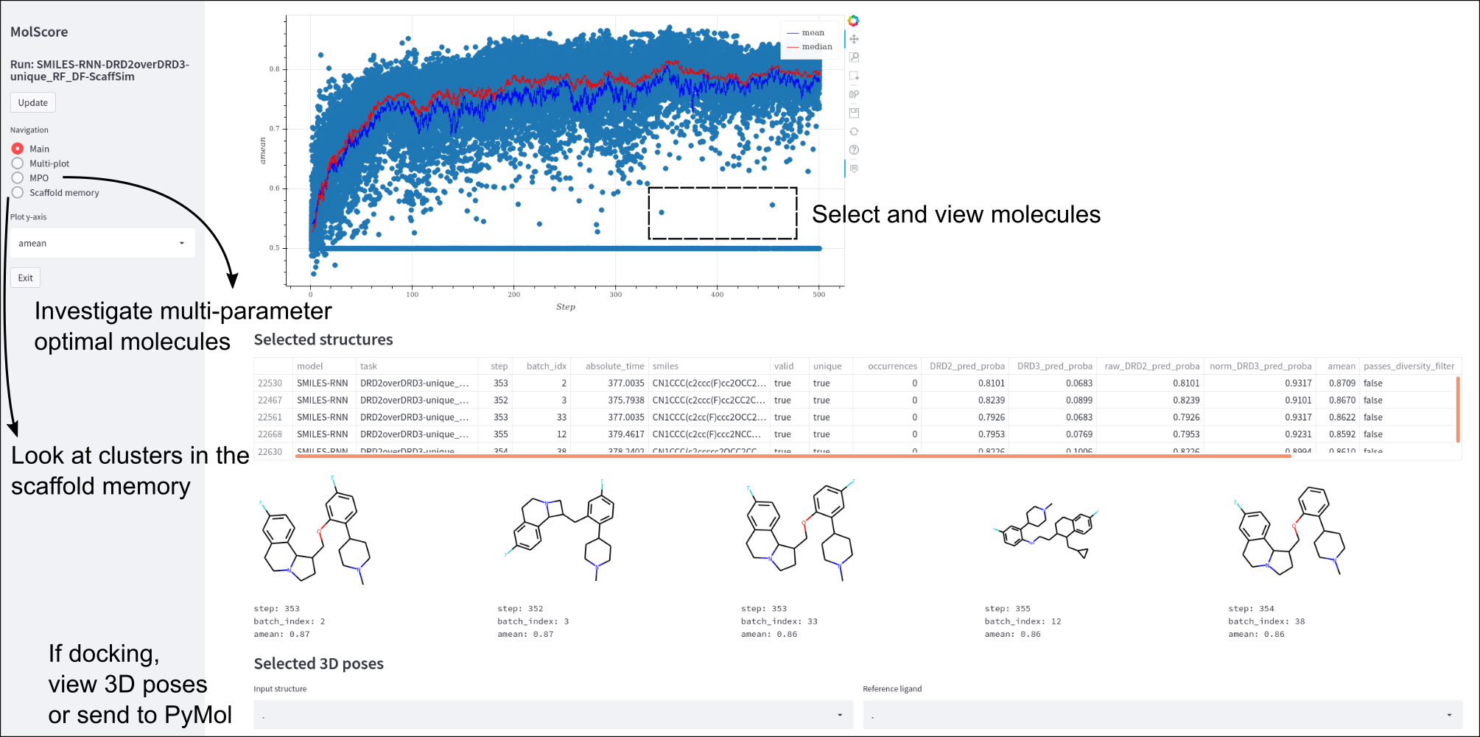
MolScore: viewing de novo molecules with monitor
When running reinforcement learning (if selected in the config), the live monitor will load in the browser

Slide 23
Conclusion
Augmented Hill-Climb
Superior optimization algorithm for sample efficiency while maintaining sensible chemistry
Directly addresses the limitations of poor sample efficiency with reinforcement learning
AHC is sensitive to mode collapse which can be rescued by appropriate diversity filters
Up to 1.5-fold greater optimization power and 45-fold fewer samples required than REINVENT
In practical terms – running AHC overnight on 10 CPUs is sufficient to optimize against ‘medium time’ scoring functions
Future work: More complex methods for importance sampling
Preprint available on ChemRxiv
GitHub: https://github.com/MorganCThomas/SMILES-RNN
MolScore
Easy-to-use python framework for scoring functions in de novo molecule generation that facilitates easier evaluation
GUI apps for easier user interaction
Central collection of objectives and metrics for de novo molecule generation
Future work: Implementation in more generative models, continued functionality improvements
Manuscript in preparation
GitHub: https://github.com/MorganCThomas/MolScore - Update soon

Slide 24

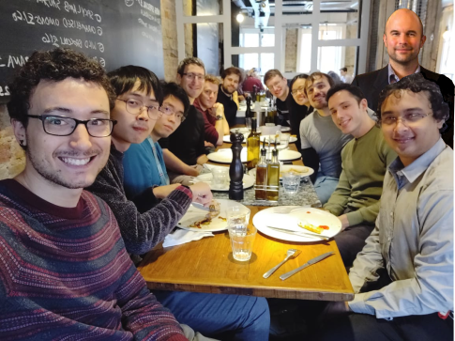




Acknowledgements
Augmented Hill-Climb (preprint)
Bender group Andreas Bender (Supervisor) + group Sosei Heptares Chris de Graaf (Industry supervisor) Noel O’Boyle (Industry supervisor) Ijen Chen Pierre Matricon + group | Authors of / contributors to open-source code + software RDKit Smina AiZynthfinder GuacaMol MOSES REINVENT Gypsum-DL RAScore AiZynthfinder Diversity filters Applicability domain filters
MolScore GitHub
@MorganThomas263
mct50@cam.ac.uk

